Slide 1

Machine Learning Final Project
Submitted by: Tamar Entin
Supervised by: Dr. Shai Gul

Slide 2
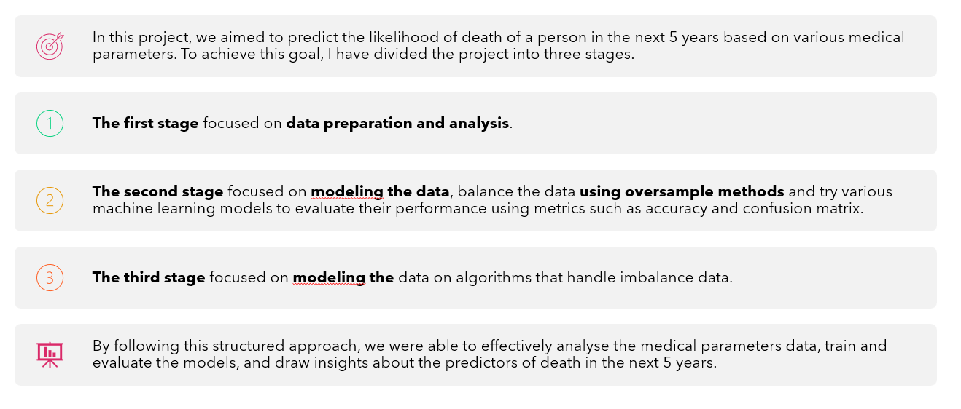
Overview
In this project, we aimed to predict the likelihood of death of a person in the next 5 years based on various medical parameters. To achieve this goal, I have divided the project into three stages.
The first stage focused on data preparation and analysis.
The second stage focused on modeling the data, balance the data using oversample methods and try various machine learning models to evaluate their performance using metrics such as accuracy and confusion matrix.
The third stage focused on modeling the data on algorithms that handle imbalance data.
By following this structured approach, we were able to effectively analyse the medical parameters data, train and evaluate the models, and draw insights about the predictors of death in the next 5 years.

Slide 3
Data Preparation and Analysis
Involved the following steps:
Data Overview and Initial Assessment
Dropping Non-Unique Values
Counting Null Values
Handling Missing Data
Converting Object Data Types to Numerical
Exploratory Data Analysis using Histograms and Correlation Analysis
Outliers Detection and Analysis using Boxplots
Descriptive Statistics
Discretizing Continuous Columns
Data Normalization
Each step will be detailed

Slide 4
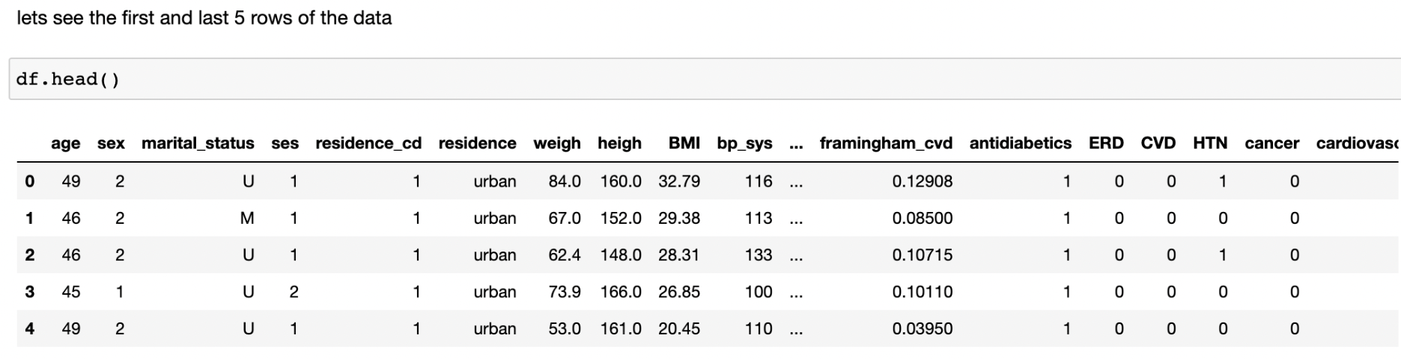
Data Overview
Our dataset includes 12438 rows and 45 columns.
There are 3 types of parameters: int, float and object.

Slide 5
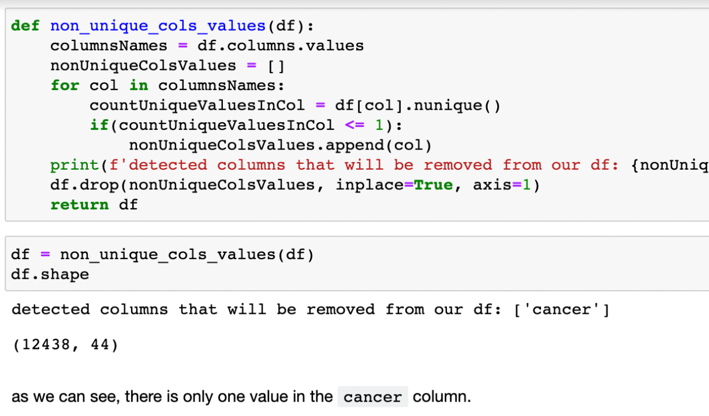
Dropping Non-Unique Values
This step checks if there are any columns in the data that have non-unique values and drops them. This is important as having non-unique values in a column does not provide any valuable information for analysis.

Slide 6
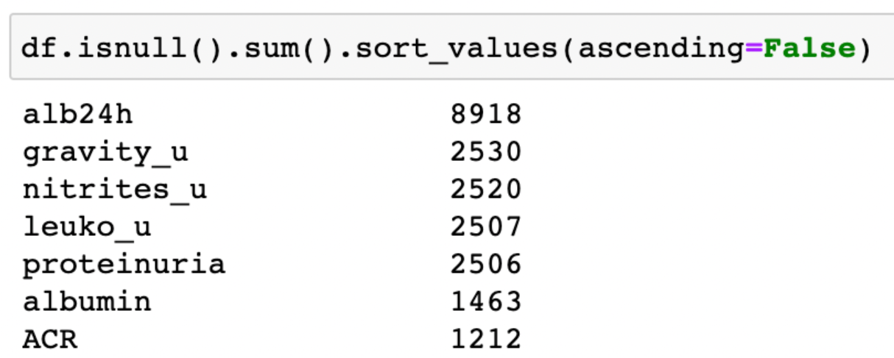
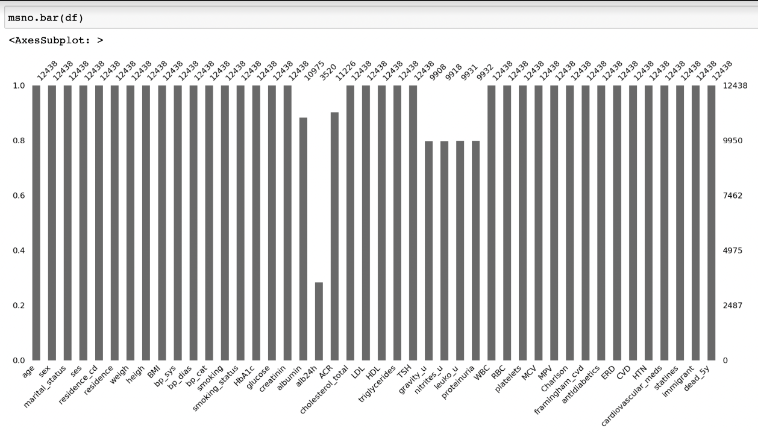
Counting Null Values
This step is used to identify and count any missing values in the dataset. Missing values are important to handle as they can affect the results of the analysis.

Slide 7
Handle Missing Data
One common approach to handle missing values is to check the correlation between the columns with missing values and the target column. If a column has a low correlation with the target column and high amount of missing values, it can be dropped as it may not contribute much to the analysis.

Slide 8
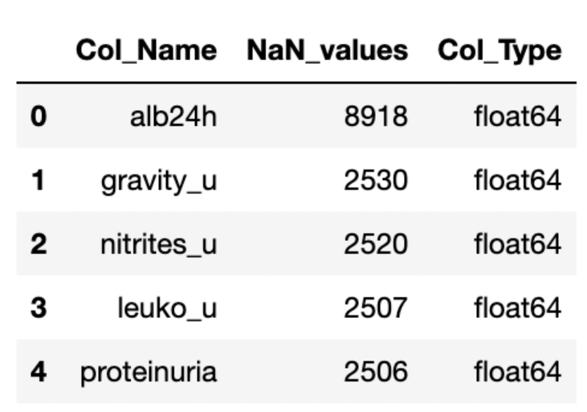
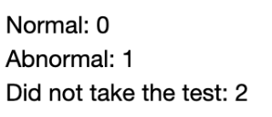
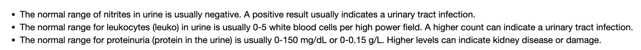
Handle Missing Data
First, let’s take a look at the columns that are missing more than 20% of the data.
‘alb24h’ has more than 70% NaN values, and therefore will be dropped.
‘gravity_u’ has the lowest correlation with ‘dead_5y’ – 0.000656, so we can drop this columns as well.
The three columns: ‘nitrites_u’, ‘leuko_u’, ‘proteinuria’
are related to the indicators found in the urine. As we can see, there is about the same amount of missing data in each column, which means that it is understandable that the tests are usually done at the same time. This is an important measure, so we will fill in the missing information base on the following categories:

Slide 9
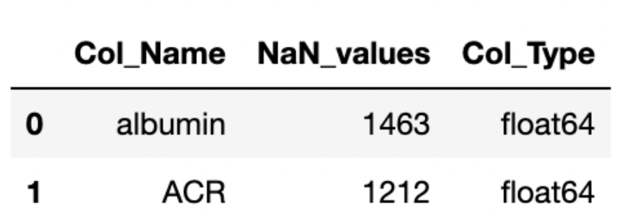
Handle Missing Data
We will do the same with the remaining columns that have missing data:

Slide 10
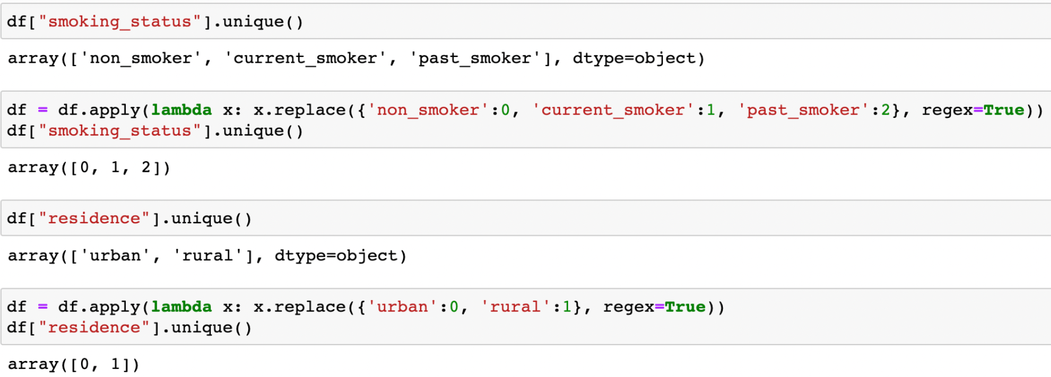
Converting Object Types to Numerical
Object type data in a dataset is typically categorical in nature and most machine learning algorithms expect input features to be numerical. Converting object type data to numerical values allows these algorithms to effectively process and analyze the data, therefore it is an important step.

Slide 11
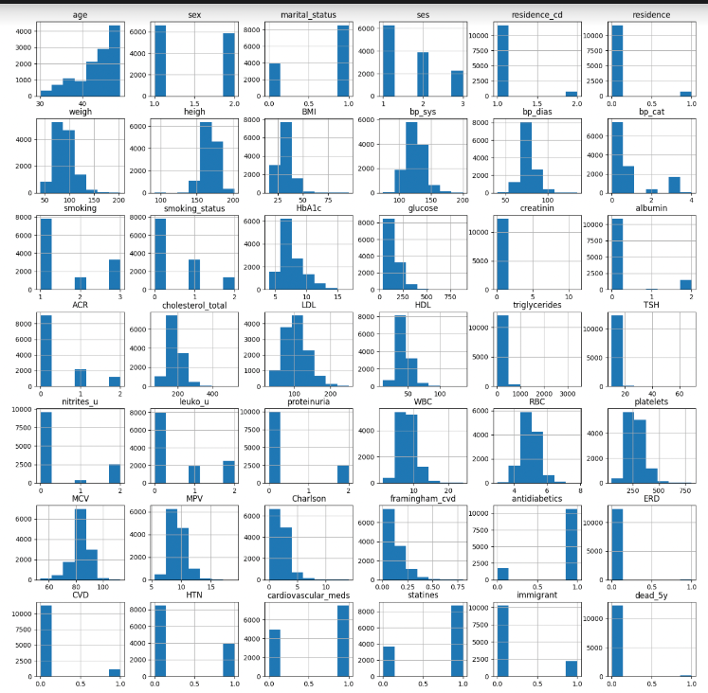
Histograms
This step involves plotting histograms for each column to visualize the distribution of values in the data. This helps to identify the spread of data, outliers, and other patterns in the data.

Slide 12
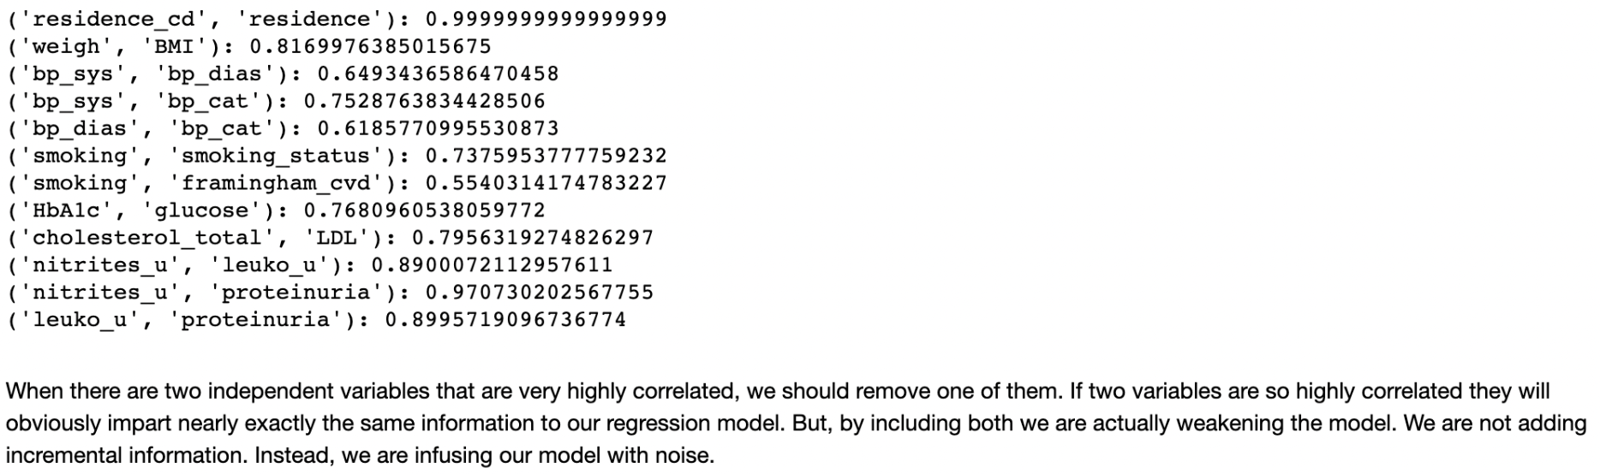
Correlations
This step is used to identify the relationship between different columns of the data. Correlation can help in identifying features that are highly correlated and help in removing features that provide redundant information.
The code removes one of two correlated columns with a high correlation coefficient (70% and higher) by selecting the column with the lower variance to drop. This is because columns with higher variance are more informative.

Slide 13
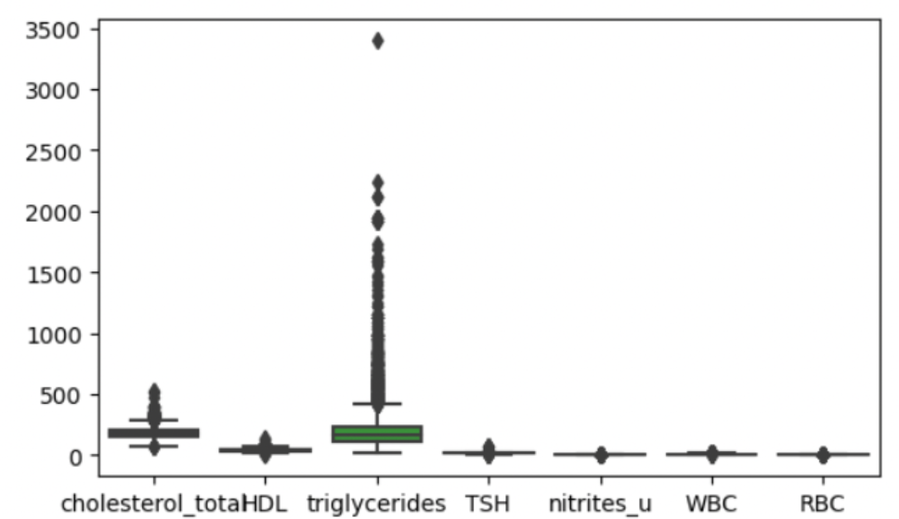
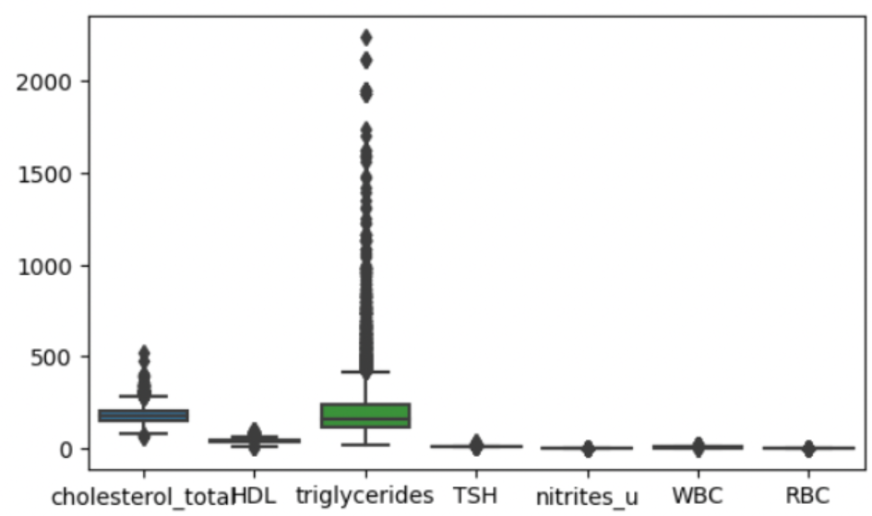
Outliers Detection & Boxplots
Outliers can significantly impact the results of the analysis and need to be handled. This step detects outliers in the data and plots boxplots to visualize the distribution of values in the data.
I detected outliers using LocalOutlierFactor (LOF) method, which is a density-based outlier detection method that is used to identify instances in a dataset that are significantly different from the rest of the instances.
93 outliers were detected.

Slide 14
Discretizing Continuous Columns
Some continuous columns in the data might need to be discretised into categories for better analysis. This step performs the discretization of continuous columns into categories.
We will use the KBinsDiscretizer class from scikit-learn to discretize the data. It converts continuous data into categorical data by dividing the range of the continuous data into a set of bins and assigning each data point to a specific bin.
We will determine the number of bins needed for KBinsDiscretizer by using determine_bins function. This method uses the data to find the optimal number of bins that minimize the number of errors in reconstructing the original distribution of the data.

Slide 15
Data Normalization
Normalization is a process of transforming the values of a dataframe to a common scale, usually within a range of 0 to 1.
There are several reasons why normalizing a dataframe is important in machine learning and data analysis:
Algorithmic stability: Some ML algorithms are sensitive to the scale of the features and may produce unstable or inconsistent results if the features are not normalized.
Better feature comparability: Normalization makes it easier to compare the relative importance of features, as it eliminates the influence of the scale of the features. This is especially important in algorithms that use distance measures or linear relationships between features.

Slide 16
Prepared Data
After cleaning the data and preparing it for analysis we remained with 12367 rows and 34 columns.
The next step is to model the data and find the best fit. This involves selecting appropriate algorithms and techniques for the analysis and evaluating the performance of the models.
In the modeling phase, we will divide our approach into two parts:
The first part will involve using the Synthetic Minority Over-sampling Technique (SMOTE) to balance the data and testing it using multiple algorithms.
The second part will involve using models that are specifically designed to address imbalanced data without the need for resampling techniques such as SMOTE.
Both of these approaches will be evaluated and compared to determine the best approach for our specific use case.

Slide 17
T-SNE
TSNE (T-Distributed Stochastic Neighbor Embedding) is a visualization technique used in data science to reduce the dimensionality of high-dimensional data into a 2D or 3D plot for better understanding and interpretation. It helps to identify patterns, clusters and relationships within the data by mapping the points in the high-dimensional space to a lower dimensional space. The technique is commonly used for exploring and visualizing complex datasets in unsupervised learning.

Slide 18
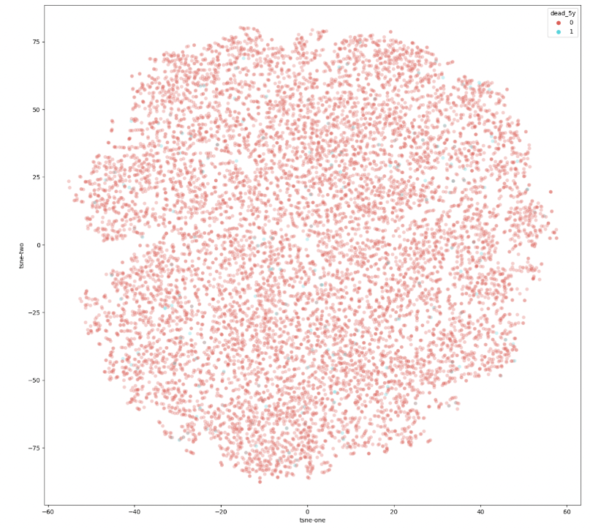
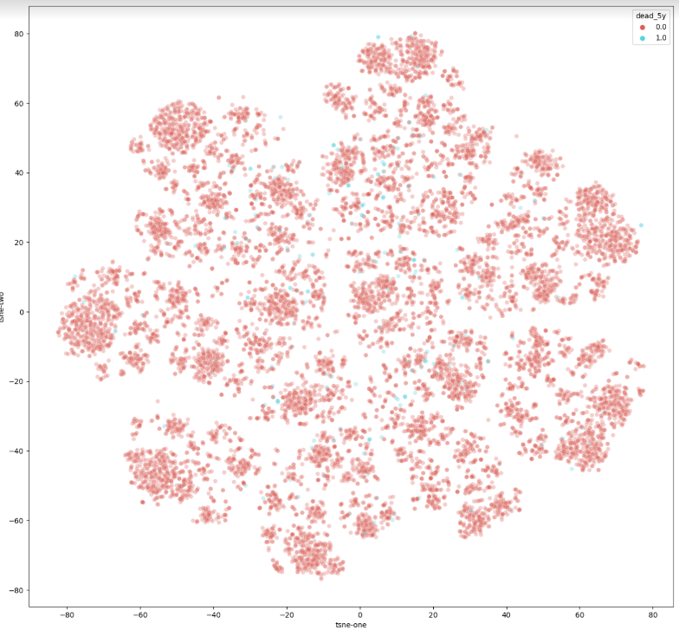
T-SNE
Clean data
Clean & Normalized data
Red – alive
Blue - dead

Slide 19
Oversampling
Oversampling is a technique used to balance unbalanced datasets, where the class distribution is unequal. In unbalanced datasets, the minority class is underrepresented, leading to a biased model that may not accurately predict the minority class.
The objective is to balance the class distribution of the target variable (y) by generating new samples in the minority class.
SMOTE (Synthetic Minority Over-sampling Technique) - generates synthetic samples of the minority class by interpolating between existing minority class instances.
I have splitted the data into training set and test set, over sampled the training set and then evaluate the model with the test set.

Slide 20
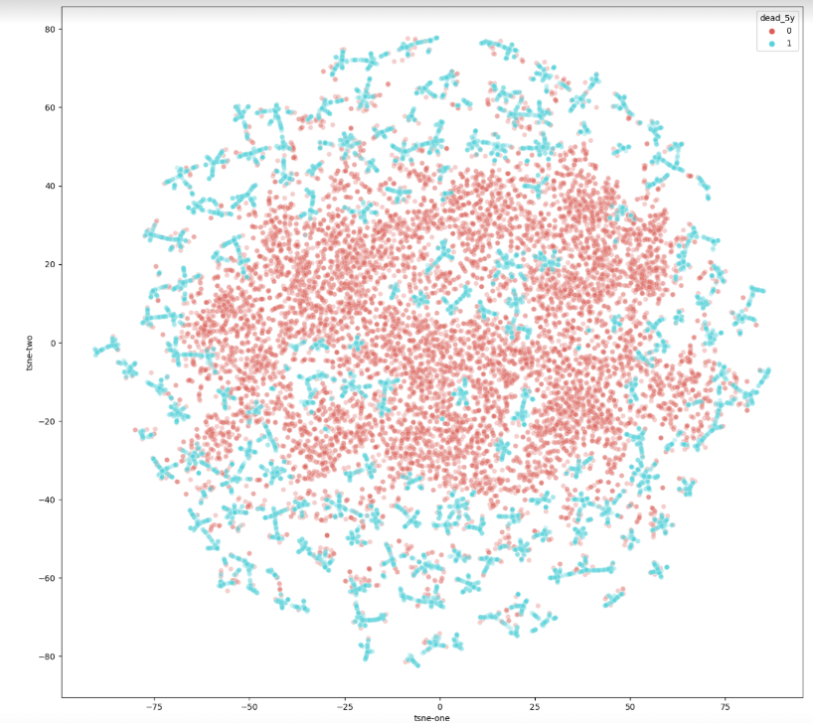
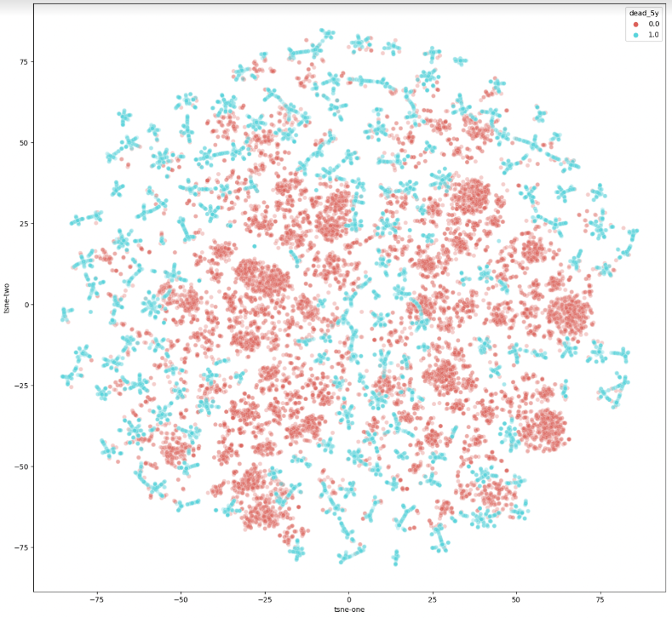
T-SNE – after oversampling
Clean data
Clean & Normalized data
Red – alive
Blue - dead

Slide 21
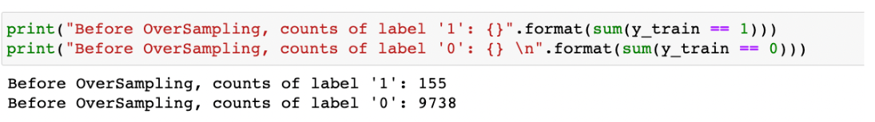
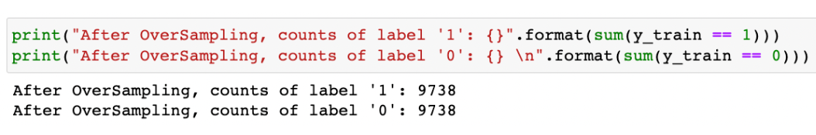
Balanced Data

Slide 22
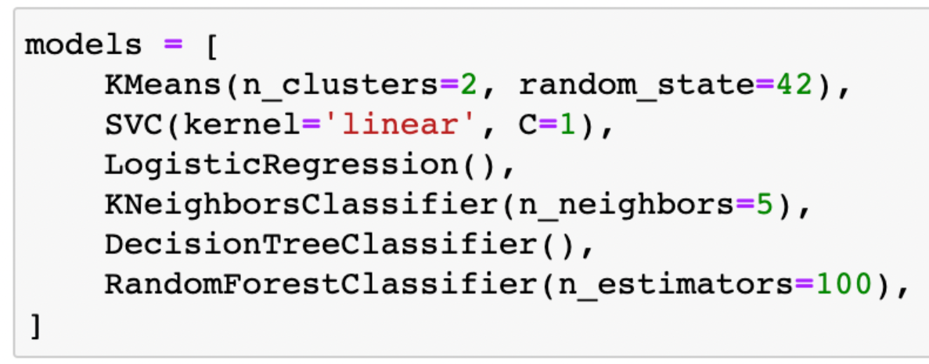
Perform K-Cross Validation
Perform k-fold cross-validation on multiple machine learning models:
And calculate the accuracy, balanced accuracy and confusion matrix for each model.

Slide 23
Evaluating Model Performance
To evaluate the performance of the models, we will look at the visualizations of the confusion matrix, accuracy, and balanced accuracy.
The confusion matrix visually shows the model's capacity to accurately classify data points into their correct categories.
The accuracy metric represents the overall accuracy of the model's predictions, while the balanced accuracy factor considers the class imbalance in the data and ensures that the model performs equally well on both the majority and minority classes.
Balanced accuracy is a valuable metric when the class distribution in the data is imbalanced. It gives a fair representation of the model's performance by considering both positive and negative cases equally. In such situations, accuracy may not be a good indicator of the model's performance as it could be biased towards the majority class..

Slide 24
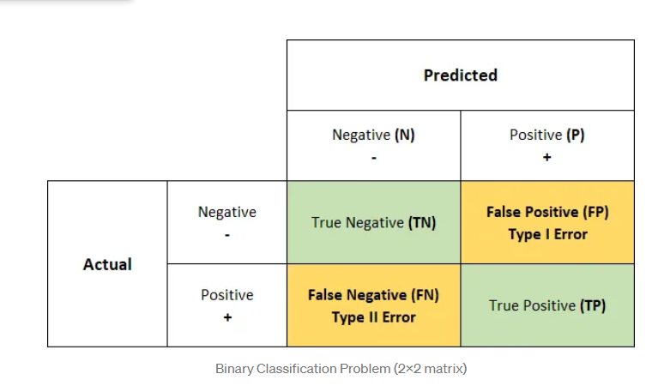
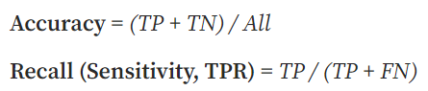
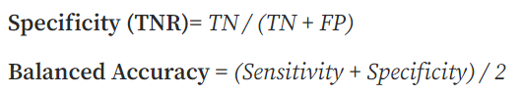
Evaluation Metrics

Slide 25
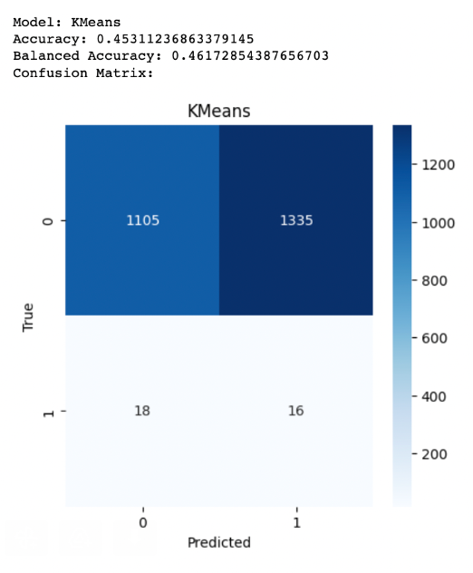
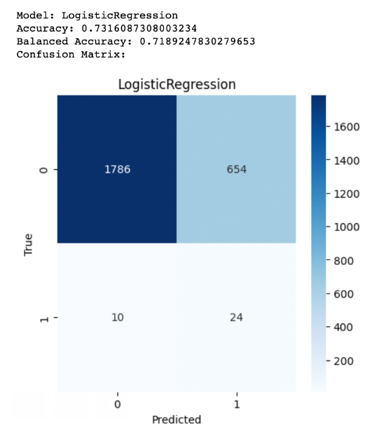
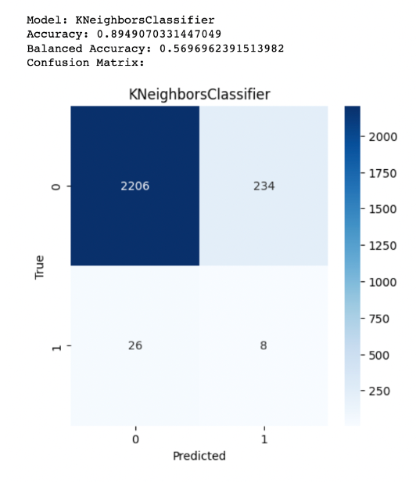
KMeans
LogisticRegression
KNN

Slide 26
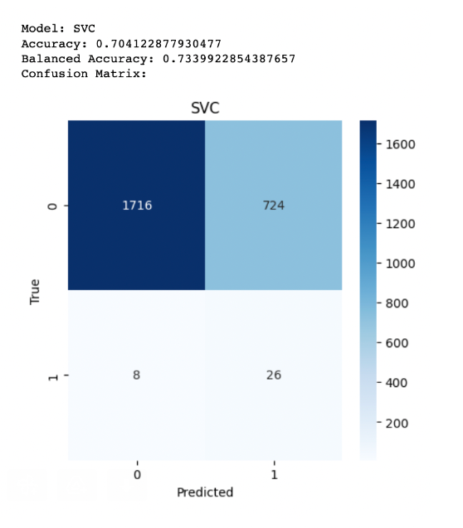
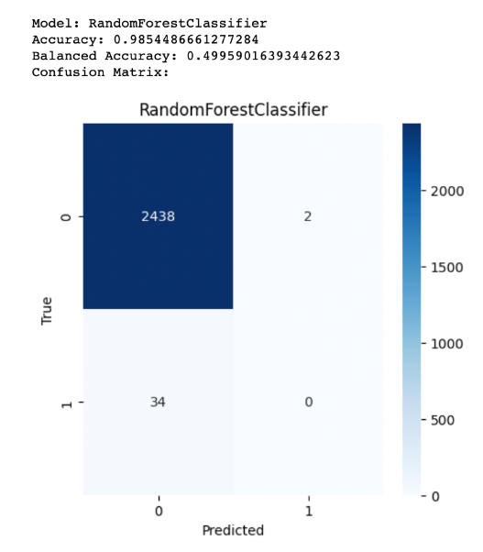
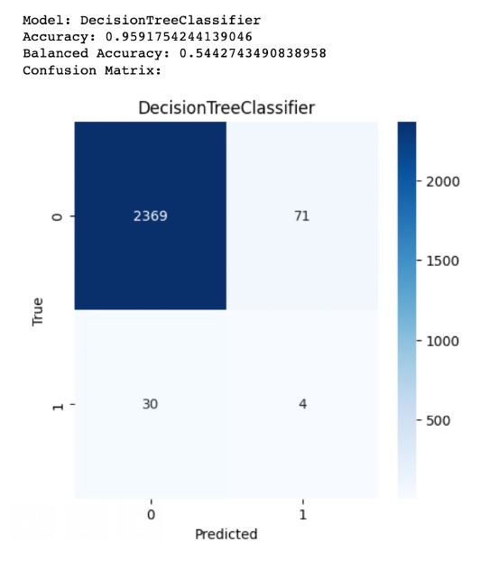
SVC
RandomForest
DecisionTree

Slide 27
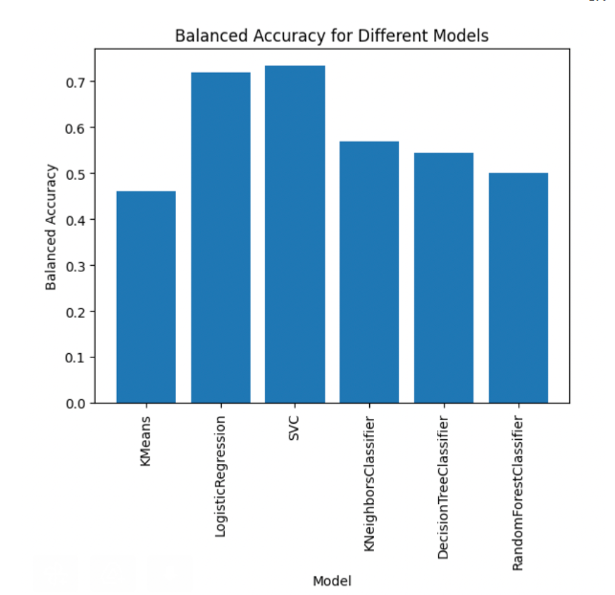
As we can see, SVC and Logistic Regression provide us with the best results – about 70% accuracy and balanced accuracy

Slide 28
Modeling Imbalanced Data with Specialized Algorithms
BalancedRandomForestClassifier and BalancedBaggingClassifier are both ensemble learning algorithms used in machine learning for classification problems.
BalancedRandomForestClassifier is an implementation of Random Forest that balances the class distribution. It balances the class distribution at the tree level by oversampling the minority class and undersampling the majority class.
BalancedBaggingClassifier is an implementation of Bagging - train several models on different subsets of the training data, and then combine their predictions to make a final prediction. that balances the class distribution by resampling the data with replacement in each iteration.
Both methods aim to balance the class distribution in the data to improve the performance of the classifier, but they balance the samples at different. BalancedBaggingClassifier balances the class distribution at the sample level for each base classifier, while BalancedRandomForestClassifier balances the class distribution at the tree level for each decision tree in the forest.

Slide 29
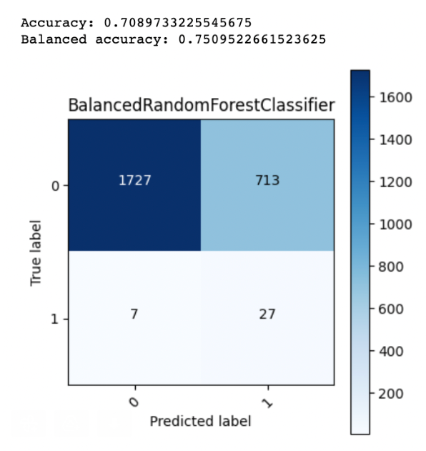
BalancedRandomForestClassifier
This model trains multiple decision trees on different subsets of the training data and aggregates their predictions to make a final prediction. To address the imbalance problem, it oversamples the minority class and under-samples the majority class before training each decision tree.

Slide 30
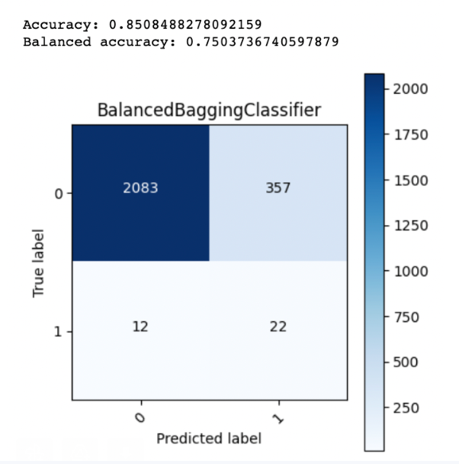
BalancedBaggingClassifier
This model creates multiple samples from the original data and balances the class distribution in each sample by either oversampling the minority class or undersampling the majority class. It then trains a base classifier on each sample and combines the results to make the final prediction.

Slide 31
Summarize
In this project, we evaluated various machine learning algorithms to determine the best fit for our data. After careful consideration and analysis, we found that the Balanced Bagging Classifier was the optimal choice, delivering the best results when applied to clean and normalized data.

